Slide 1
5. Sequence Diagram- Prod
Use this space for your Sequence Diagram (refer to the example documents if needed)
“A sequence diagram consists of a group of objects that are represented by lifelines, and the messages that they exchange over time during the interaction. A sequence diagram shows the sequence of messages passed between objects. Sequence diagrams can also show the control structures between objects.” - IBM
| | | | |
| Login | | | |
|----------------------------------> | | | |
| | | | |
| Run Flow | | | |
|----------------------------------> | | | |
| |Capture Username | | |
| |----------------> | | |
| | Launch EXE | | |
| |-------------> | | |
| | | Display UI | |
| <--------------------------------- | | |
| Enter Details | | | |
|----------------------------------> | | | |
| | | Generate Docs | |
| | |--------------------------------> | Save Files |
| | |<--------------------------------- | |
| | Wait for Completion | | |
| |<----------------- | | |
| |----------------------------------------------------------------------------------------------------------------------- |Send Email
| |<-------------------------------------------------------- ------------------------------------------------------------ -|
| Show Success | | | |
|<------------------------------------ | | | |
User
PAD Flow
Python App
OneDrive
Outlook

Slide 2
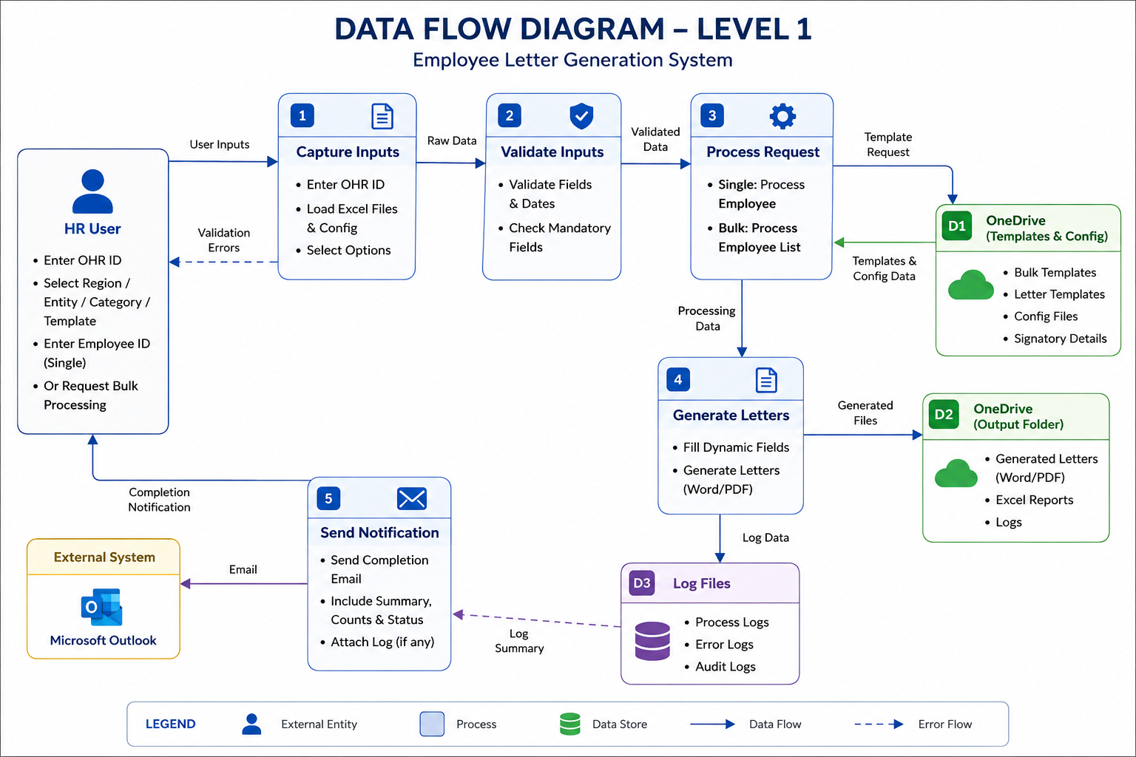
6. Data flow diagram
Use this space for your Data Flow Diagram (refer to the example documents if needed)
“A data flow diagram (DFD) maps out the flow of information for any process or system. It uses defined symbols like rectangles, circles and arrows, plus short text labels, to show data inputs, outputs, storage points and the routes between each destination.” - LucidChart
HR User
• Login via SSO
• Role auto-assigned
• Submit request
1 SSO Login &
Role Assignment
• Authenticate via SSO
• Auto-assign role
2 Capture & Validate
Inputs
• Enter OHR ID & fields
• Validate mandatory fields
3 Process Request
• Single: process employee
• Bulk: process employee list
SSO Login
Session+Role
Validated Data
Template
Processing Data
4 Generate Letters
• Fill dynamic fields
• Generate Word/PDF
D1 S3 Bucket
(Templates & Config)
• Bulk & letter templates
• Config & signatory data
Completion Notification
Templates
Log Data
Generated Files
Microsoft Outlook
• External system
5 Send Notification
• Completion email
• Attach summary/log
D3 Log Files
• Process / error logs
• Audit logs
D2 S3 Bucket
(Output Folder)
• Generated letters
• Excel reports & logs
Email
Log Summary
LEGEND
External Entity
Process
Data Store
Data Flow
Error/Log Flow

